Slide 1
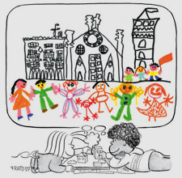
Sguardi che cambiano il mondo
Abitare insieme le città delle bambine e dei bambini
DOCUMENTATION
English
Centro Internazionale Loris Malaguzzi | Via Bligny, 1-A - 42100
Reggio nell'Emilia | 21-30 luglio 2014

Slide 3
“The opportunity to meet with several nations and possibility of teaching and learning through feelings of friendship with people who practice the pedagogy Freinet…
meet again friends all wrapped in the magic of international atmosphere …
the chance to experience together”

Slide 4
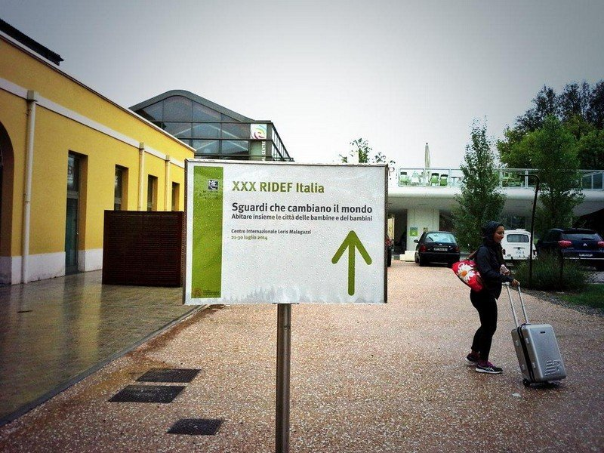
In this way the majority of the participants described the participation to the Ridef of Reggio Emilia To not lose the richness of the experience, we have gathered the most representative documents and summaries to provide a witness and a memory

Slide 5
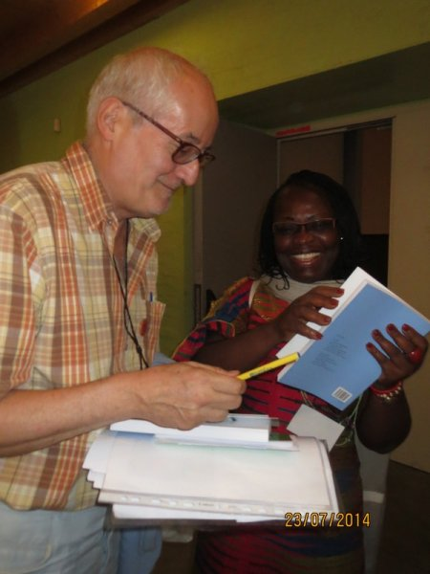
The research for documents was long and patient, the participants have provided, in many cases, the writings about their experience in the original language, hence the decision to accompany the texts with a translation into English and French.

Slide 6
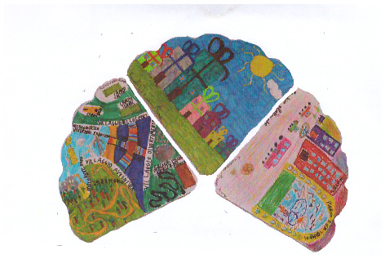
Contents are as follows:
- Presentation of Ridef 2014 - References to the Pedagogy Freinet yesterday and today - Reggio children (presentation of the center and its activities) - Hospitality (Pre Ridef, articles and photos of gadgets ready to receive participants)

Slide 7
List of countries present in Reggio Emilia
advertisement
PLENARY (meetings at the beginning and at the end)
LONG Workshop : reports of some of the trainers and participants: "Our presence at these workshops allowed us to learn about the experiences of a large number of people, to review our practices and enrich our vision by opening new avenues to explore."

Slide 8
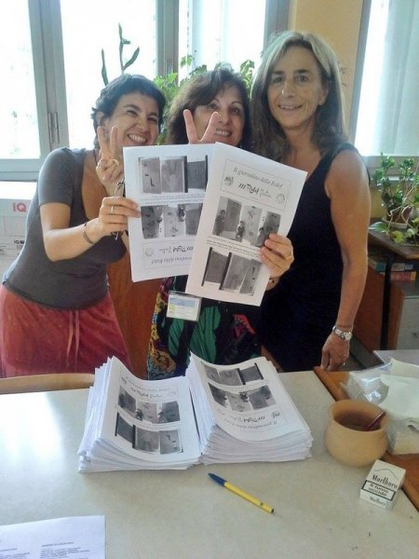
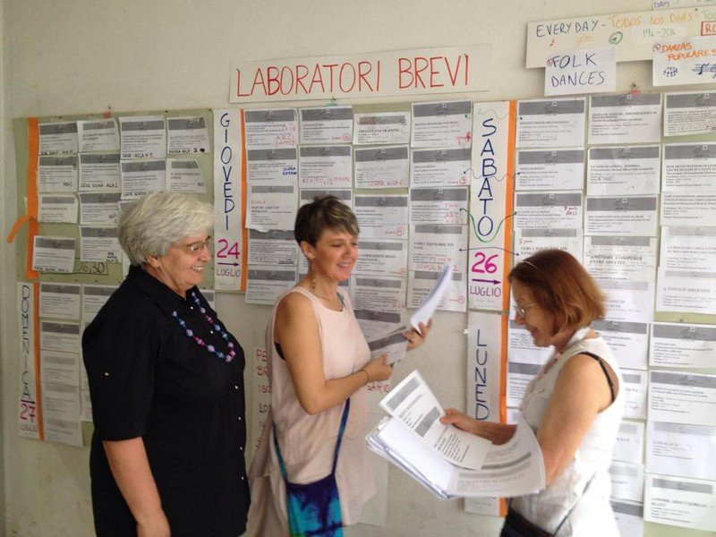
SHORT WORKSHOPS : LIST AND SOME REPORTS - PRESENTATION OF THE BOOK OF RIGHTS: The presentation of the book "We must not be silent" and the distribution to all to the participants were very special and significant moments of this RIDEF.

Slide 9
ROUND TABLES
"The roundtables were other places for reflection on themes of high quality, and also opportunities for sharing experiences. In particular, the forum day has been, in my opinion, a great success. Concerning the communications in the language groups, I can say that they were intense and important moments for dialogue and free expression. "A. Mengue

Slide 10
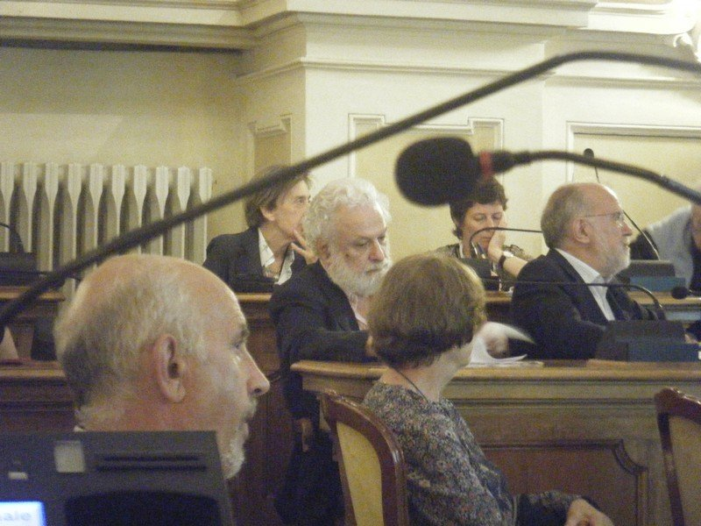
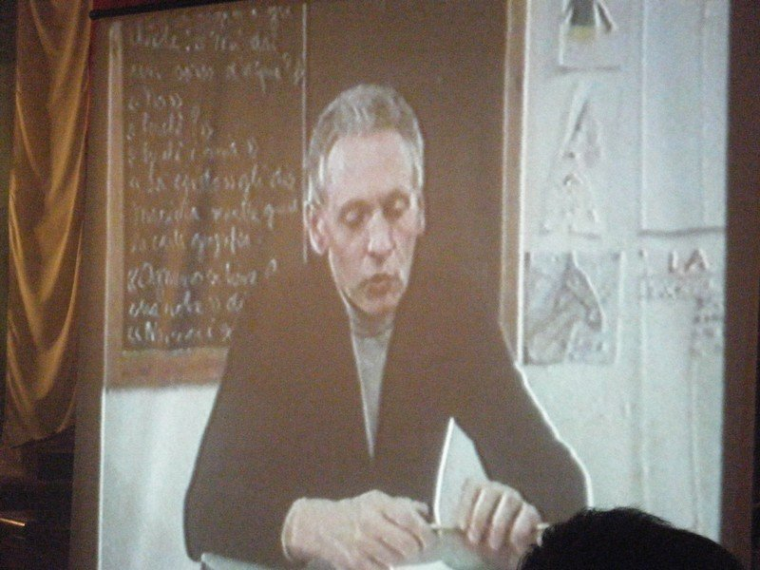
The evening dedicated to Mario Lodi (with Tonucci /Alfieri ed others) –

Slide 11
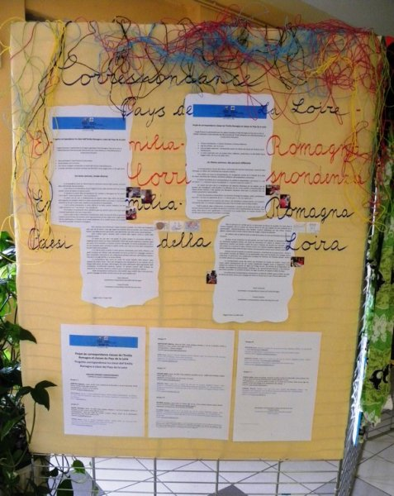
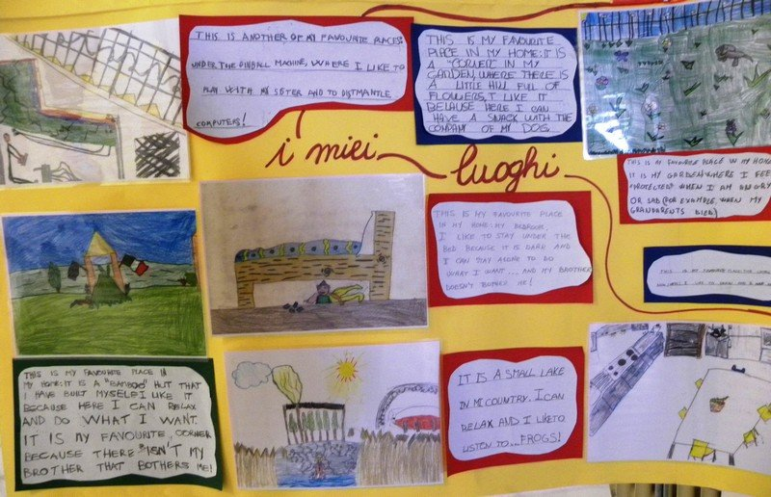
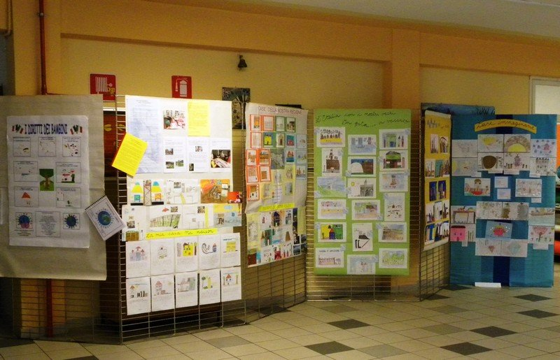
EXHIBITIONS SOCIAL REPORT PRE / POST RIDEF THANKS

Slide 12
EVALUATION - Questionnaire - there are graphs showing the consideration made by the participant concerning strengths and weaknesses of the event: - EXCURSIONS on the territory showed the largest number of extremely positive feedback, also the significance of the topic and the consistency of educational events have shown significant results.
- Really important were considered the round table and the long and short workshop

Slide 13
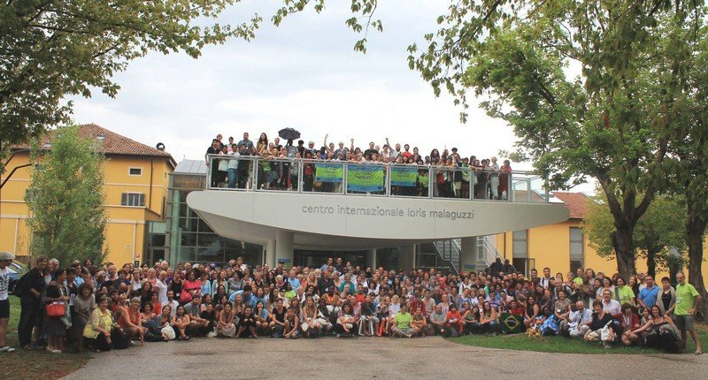
WE THANK EVERYONE: SPEAKERS – REPORTERS -PHOTOGRAPHERS – TRANSLATORS – OTHERS …..THAT HAVE CONTRIBUTED WITH THEIR WORK TO GIVE FORM AND CONTENT TO THE THE DOCUMENTATION OF THIS RIDEF

